Slide 1
F21 - CS263 Final Presentation
11/22/2021
ns-3 using C++ vs. Python: A Runtime Comparison
Presenters:
Nawel Alioua - 1st year Ph.D.
Yuqing Wang - 2nd year Ph.D.
Computer Science Department

Slide 2

Outline
Introduction to ns-3
Project Idea
Introduction to profiling
C++/Python profilers
Perf: System-wide Performance Analyzing Tool
Network Scenario for Simulation
Execution Time comparison of the Ping6 scenario in C++ vs Python
Conclusion and plan for project completion

Slide 3
Introduction to ns-3
ns-3 is a discrete-event network simulator for internet systems [1]
Free, open source software for research and education.
Discrete-event simulation (DES): the operations of a system are modelled as a discrete sequence of events in time [2]
No changes in the system assumed between events
Can jump to the occurrence time of the next event

Slide 4
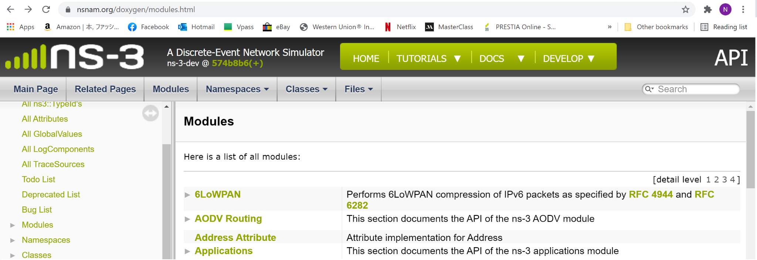
Introduction to ns-3
ns-3 is a discrete-event network simulator for internet systems [1]
Models a wide variety of modules
Users can create custom modules anywhere in the protocol stack.
Has a rich documentation
Class reference, manual, tutorials

Slide 5
Introduction to ns-3
ns-3 is written in C++, but can be called using Python [4]
Python bindings provide support for importing ns-3 model libraries as Python modules
Major limitations
The original C++ API is not 100% supported in Python
The documentation for the Python bindings is less detailed than C++ API’s.

Slide 6
Project Idea
What: Question we want to explore
How:
How does the use of Python bindings impact the performance of ns-3 modules compared to a C++ execution ?
Run a simple network scenario in both C++ and Python, and compare performance metrics using a profiler.

Slide 7
Introduction to Profiling
Profiling is...
A program analysis that informs about [5]:
How long each part of the code (functions, blocks) took to execute, how many calls, etc → flat profile
Many more metrics: memory usage, cache hits/misses, branch prediction, etc.
Which functions called which other functions while executing → call graph

Slide 8
C++ / Python Profilers
C++ | Python
GNU gprof Gives information on the percentage of CPU usage, the cumulative execution time, the number of calls to each function, ..etc Need to compile and link the code with profiling enabled by adding ‘-pg’ flags to the compiler command (and ‘-l’ for line-by-line profiling) Run the program and get the output in gmon.out. Run gprof command to interpret the information in gmon.out. Valgrind Is an instrumentation framework that includes several tools (non-exhaustive list): Memcheck: detects memory-management problems Cachegrind: cache profiler. Pinpoint the sources of cache misses. Massif: heap profiler. It produces a graph showing heap usage over time. | cProfile: A profiler written in C that can help gather various metrics including total execution time, number of function calls, execution time per function, etc. It has a reasonable overhead that makes it suitable for profiling long-running programs line_profiler: A Python module to perform line-by-line profiling of functions. Implemented in C in order to reduce the overhead of profiling. memory_profiler: A memory usage monitoring tool that helps to understand line-by-line memory consumption of a process. It is a pure python module

Slide 9
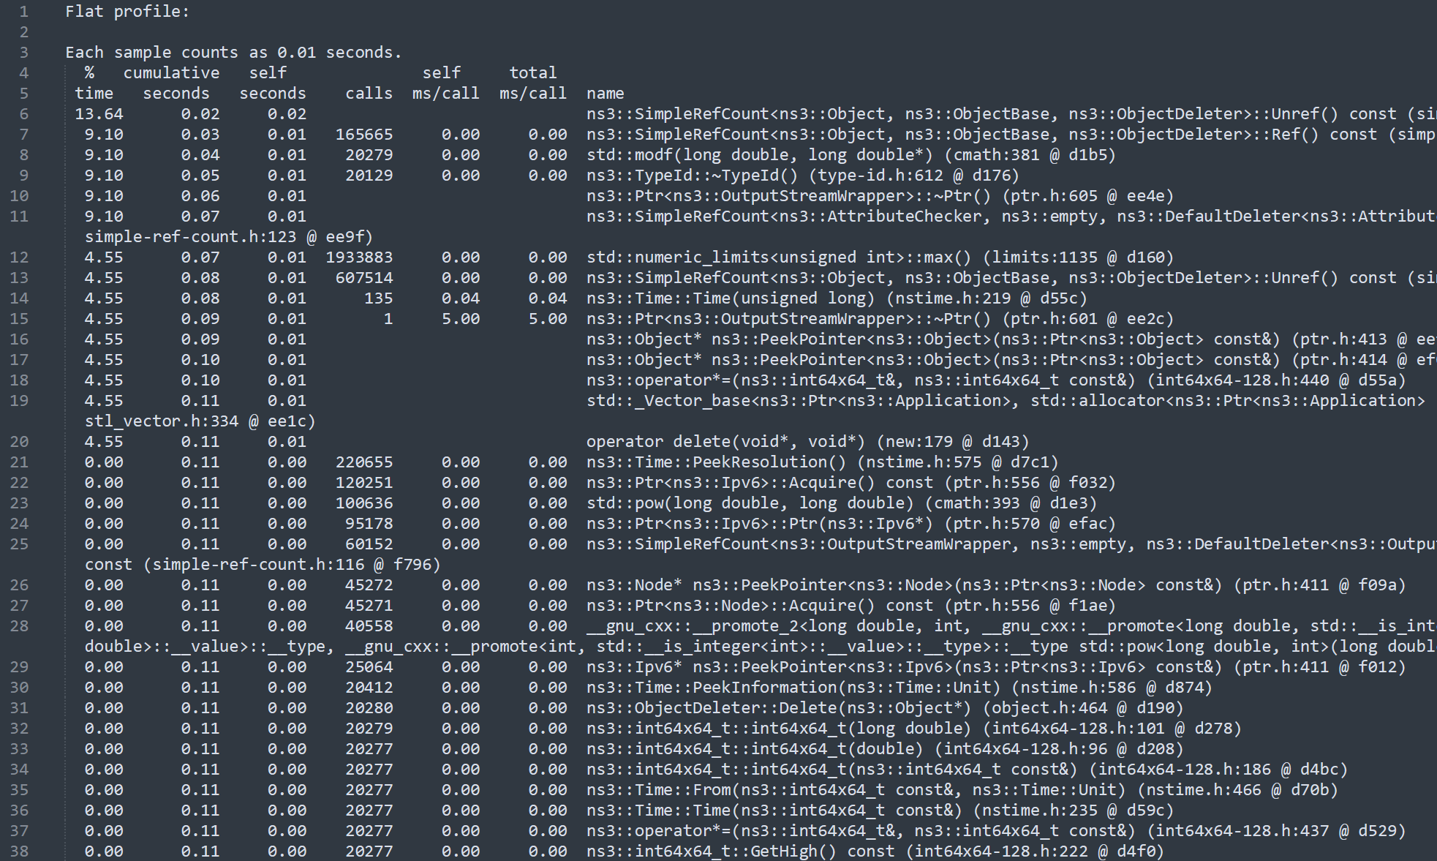
Gprof Sample Output (C++)
xdfsdfs

Slide 10
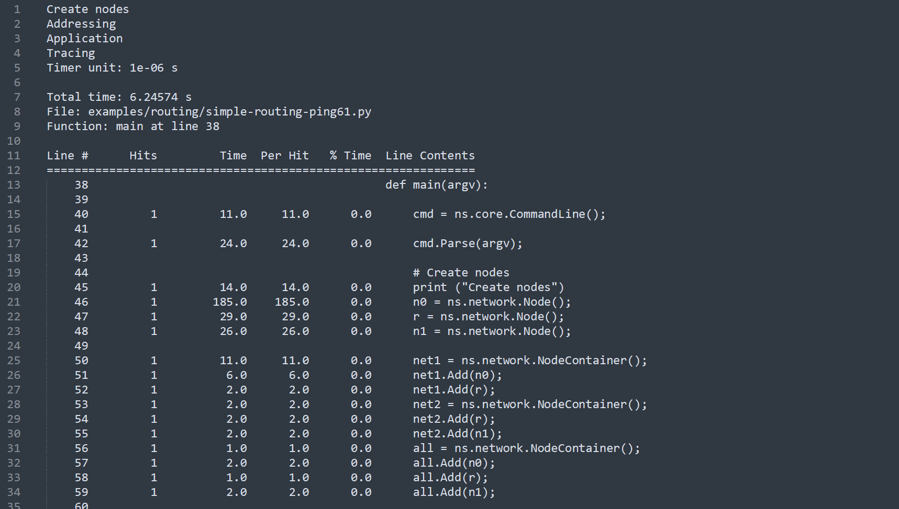
Line_profiler Sample Output (Python)

Slide 11
C++ / Python Profilers
Issues when using a different profiler per language
Solution: Use a system-wide profiler
Different output format and/or available metrics → difficult to make them match for comparison
Different performance overhead
Example (execution time): Some profilers slow down the program more than others → Difficult to compare execution times…

Slide 12
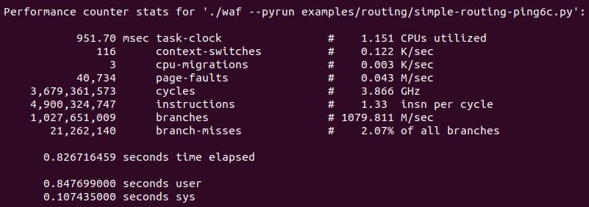
Perf: System-wide Performance Analyzing Tool
Perf (CPU Profiling)
Performance monitoring:
Software: low precision
Hardware: specialized counters on the CPU
Perf: interface to hardware and software events
CPU Statistics (perf stat):
Notes:
Task-clock: total CPU execution time for this task
Context switch: the process of storing the state of a process, so it can be restored and resume execution later
CPU migration: when the process migrates from one core to another
Page faults: a program attempts to access data in its address space but not currently located in system RAM
CPU cycles: counting of special hardware events such as clock ticks
Instructions: approximate count of instruction executed
Branches: the number of branches during execution
Branch misses: the number of cases where branch prediction failed to guess the execution path right

Slide 13
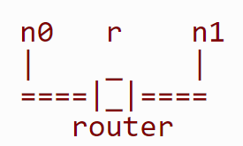
Network Scenario for Simulation
Ping6 application
Internet Control Message Protocol version 6 (ICMPv6)
Point-to-point test
Check the connectivity between a device and another device
Send IP packets (ICMP Echo Requests)
We vary the maximum number of packets sent
maxPacketCount = {5, 10, 20, 40, 80, 160, 320, 640, 1280, 2560}
Network topology:

Slide 14
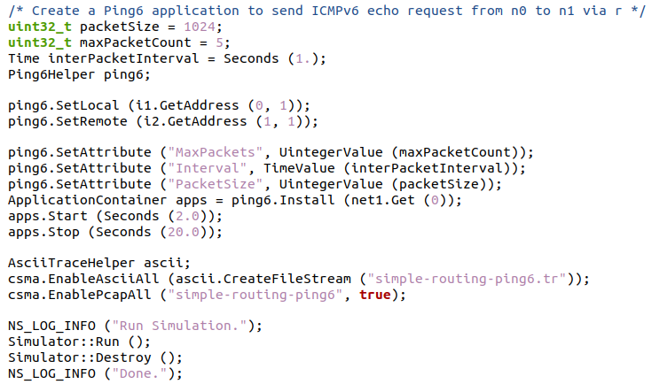
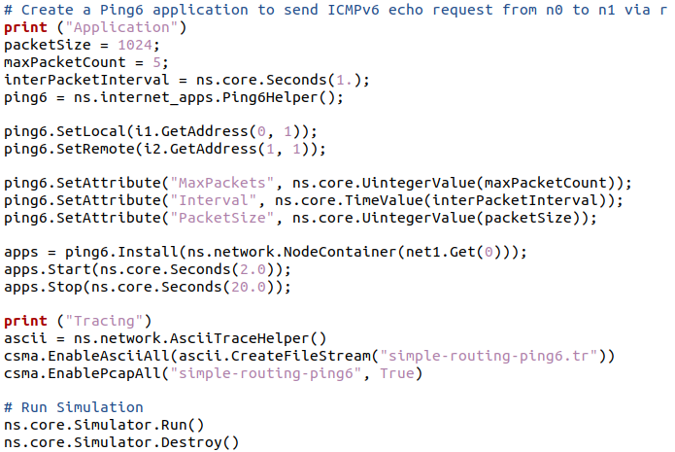
Network Scenario for Simulation
Ping6 application
C++ Source Code
Python Source Code

Slide 15
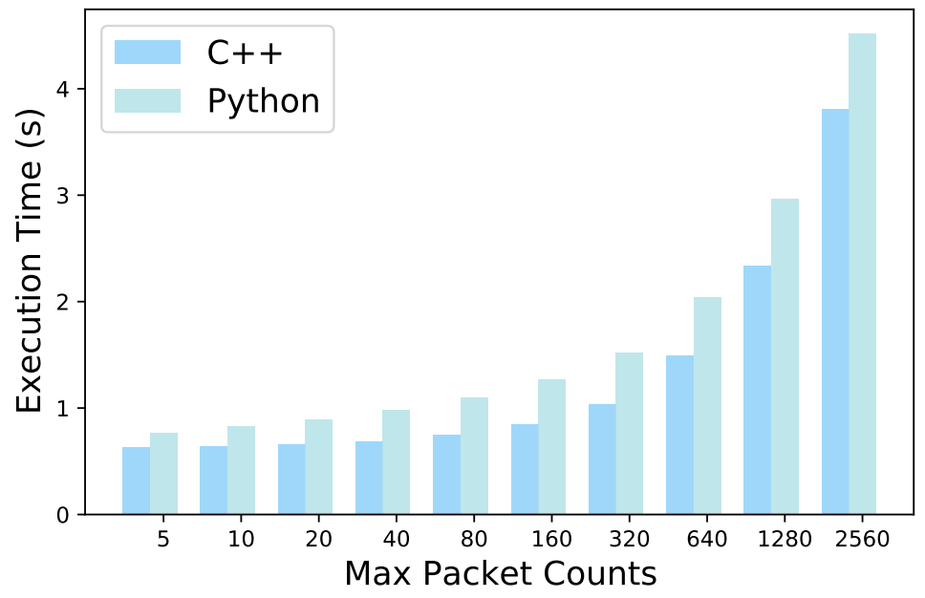
Figure 1: Execution Time of the Ping6 scenario in C++ vs Python
Notes:
Figure 1 shows that the execution time of the Ping6 scenario is always longer in Python vs. in C++, the difference increasing with the number of packets sent.

Slide 16
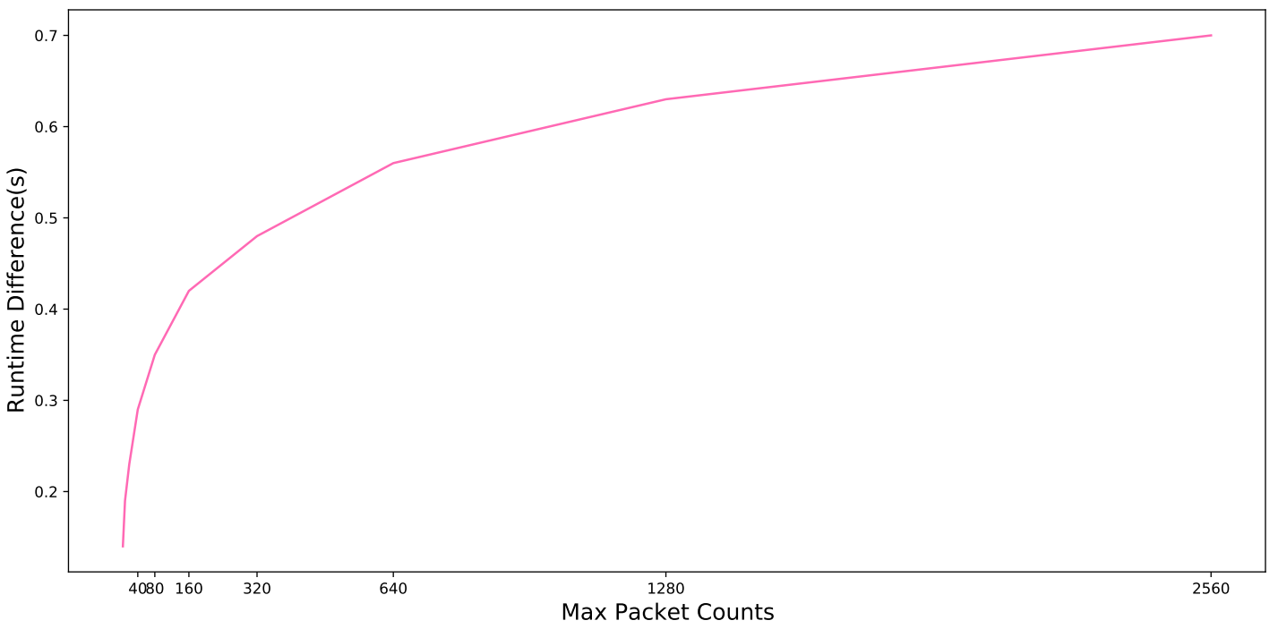
Figure 2: Difference in Execution Time of the Ping6 scenario between C++ and Python
Notes:
However, Figure 2 shows that the difference in execution time is non-linear (near logarithmic).
→ the overhead of the Python bindings is not proportional to the number of packets sent.

Slide 17
Conclusion and plan for project completion
We have run the Ping6 scenario on ns-3 both in C++ and Python and evaluated the execution time in both.
Running the scenario in Python is slower than running it using the native C++ API.
Until Dec, 6th:
Investigate memory usage of the Ping6 scenario in both languages (using valgrind (memcheck or Massif)?).
Complete the report.

Slide 18
References
[1] ns-3 Network Simulator. https://www.nsnam.org/
[2] Discrete-event simulation. https://en.wikipedia.org/wiki/Discrete-event_simulation
[3] ns-3 Doxygen. https://www.nsnam.org/doxygen/modules.html
[4]Using Python to run ns-3. https://www.nsnam.org/docs/manual/html/python.html
[5] GNU gprof. https://ftp.gnu.org/old-gnu/Manuals/gprof-2.9.1/html_mono/gprof.html#SEC1

Slide 19

Questions?

